Slide 1
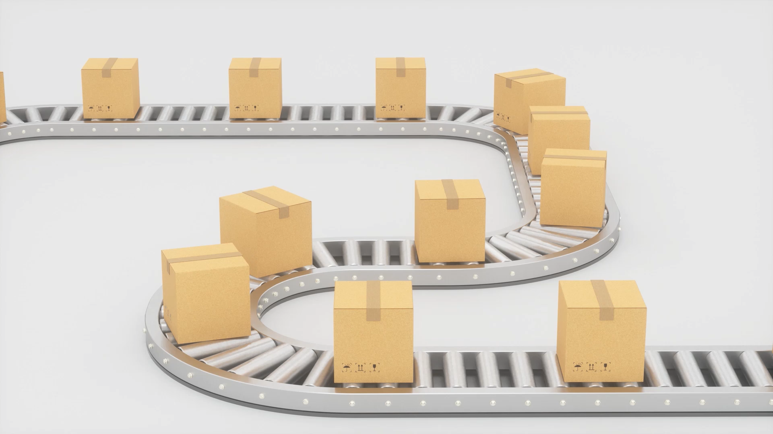
Sales Inventory System
Team 4: Anthony Colley, Jose Vazquez, Joshua Swilling, Kennedy Sutton
SDEV 265 Fall 2024

Slide 2
Requirements Document
1. Software Introduction
Problem Addressed: Difficulty managing inventory and tracking sales.
Solution: A Python-based inventory management system with automated stock updates, transaction tracking, and sales insights.
Features:
User-friendly GUI for ease of use.
Database integration for automated updates and backups.
2. System Requirements
Team Roles: Python Developer, SQL Developer, UI Designer, Tester, and others.
Technical Needs:
SQL database functionality.
Object-oriented programming.
Graphical User Interface.

Slide 3
Requirements Document
3. System Development Life Cycle (SDLC)
Planning: Scope, timeline, and risk assessment.
Analysis: Requirements and validation.
Design: GUI, database schema, and modular structure.
Development: Backend, frontend, and database integration.
Testing: Field testing, data integrity checks, bug resolution.
Deployment: Initial system setup and user training.
Maintenance: Feedback-based updates and new features.

Slide 4
Feasibility Study
Technical Feasibility
Uses accessible technology (Python, MySQL)
Tools: Github, Trello, Discord
Legal Feasibility
Open-source tools, no licensing concerns
Prioritizes data privacy and security
Operational Feasibility
Roles defined, regular progress check-ins
User-friendly interface minimizes training needs
Economic Feasibility
Hypothetical cost-effective approach using free tools
Operational benefits outweigh minimal costs

Slide 5
Project Plan
Project Organization
Roles
Designer/Organizer | Jose Vazquez | Ensures an easy design for customers and makes sure that the team can easily implement it into the program. Working on the database.
Organizer/Programmer-Backend | Anthony Colley | Ensuring that all assignments are completed on time according to our schedule and writing the program code.
Programmer-Frontend | Joshua Swilling | Write the program code, specifically the frontend, ensuring that the design meets the customer's requirements
Tester | Kennedy Stokes-Sutton | Conducting all analyses and testing everything to ensure that the program works at peak performance without bugs, guaranteeing customer satisfaction

Slide 6
Project Plan
Development the inventory
Make the database in SQL
Plaining
Classes
Activities
Programming the Inventory
Programming the sales
Programming the History
Users
Programming users
Implementing the inventory system with the database
Implemeting the sales
History Transaction
Be able to see any sale, or inventory update
Login Window
Implemeting Inventory in the program
Be able modify, add, delete items
Implemeting the Tables
Testing
Implemeting sales with the inventory
Be able to look for any item
Be able to modify, add, delete items
Be able to do sales
Keep tracking of each sale
Testing
Testing
Be able to give permissions to users
Be able to delete, edit, or add users
Testing
Testing
Programmign the login
Requesting login to be sure that the right user is using the program
Testing
Keep tracking of each update
Testing
Making sure that the design meeting team scope
Everything working as expected
Project Breakdown

Slide 7
Risk Assessment
Key Risks
Late Delivery
Development delays or team members falling behind.
Software/Equipment Failure
Issues with tools like Github or Trello causing file corruption or data loss.
Team Member Unavailability
Unexpected emergencies limiting productivity.
Project Scope Changes
Midway adjustments requiring rework.
Hardware Failure
Device malfunctions affecting development progress.
Presentation Completion Issues
Incomplete presentation due to coding focus.
Time constraints leaving minor bugs unresolved.
Debugging Limitations
Time constraints leaving minor bugs unresolved.

Slide 8
Risk Assessment
Mitigation Strategies
Schedule Risks:
Clear timeline with milestones and weekly check-ins to monitor progress.
Adjust focus to prioritize essential features if delays occur.
Technical Risks:
Regular GitHub backups to prevent data loss.
Local copies maintained to address software failures.
Resource Availability:
Defined roles with tasks tracked in Trello.
Reallocate tasks if a member is unavailable.
Scope Management:
Fixed scope defined upfront.
Proposed changes require team approval to avoid unnecessary rework.
Presentation Quality:
Allocate time toward visuals in the final phase to ensure quality polish.

Slide 9
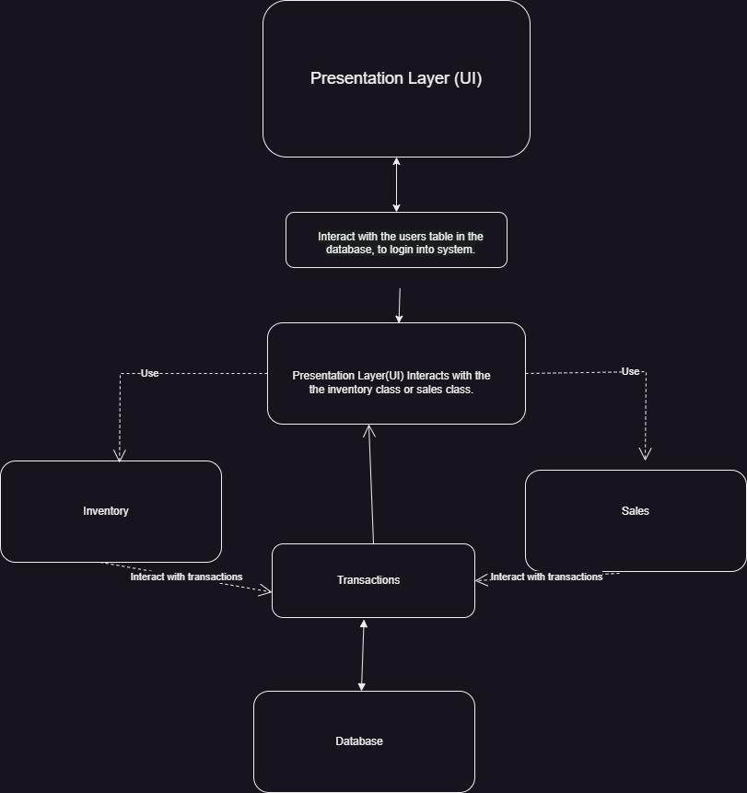
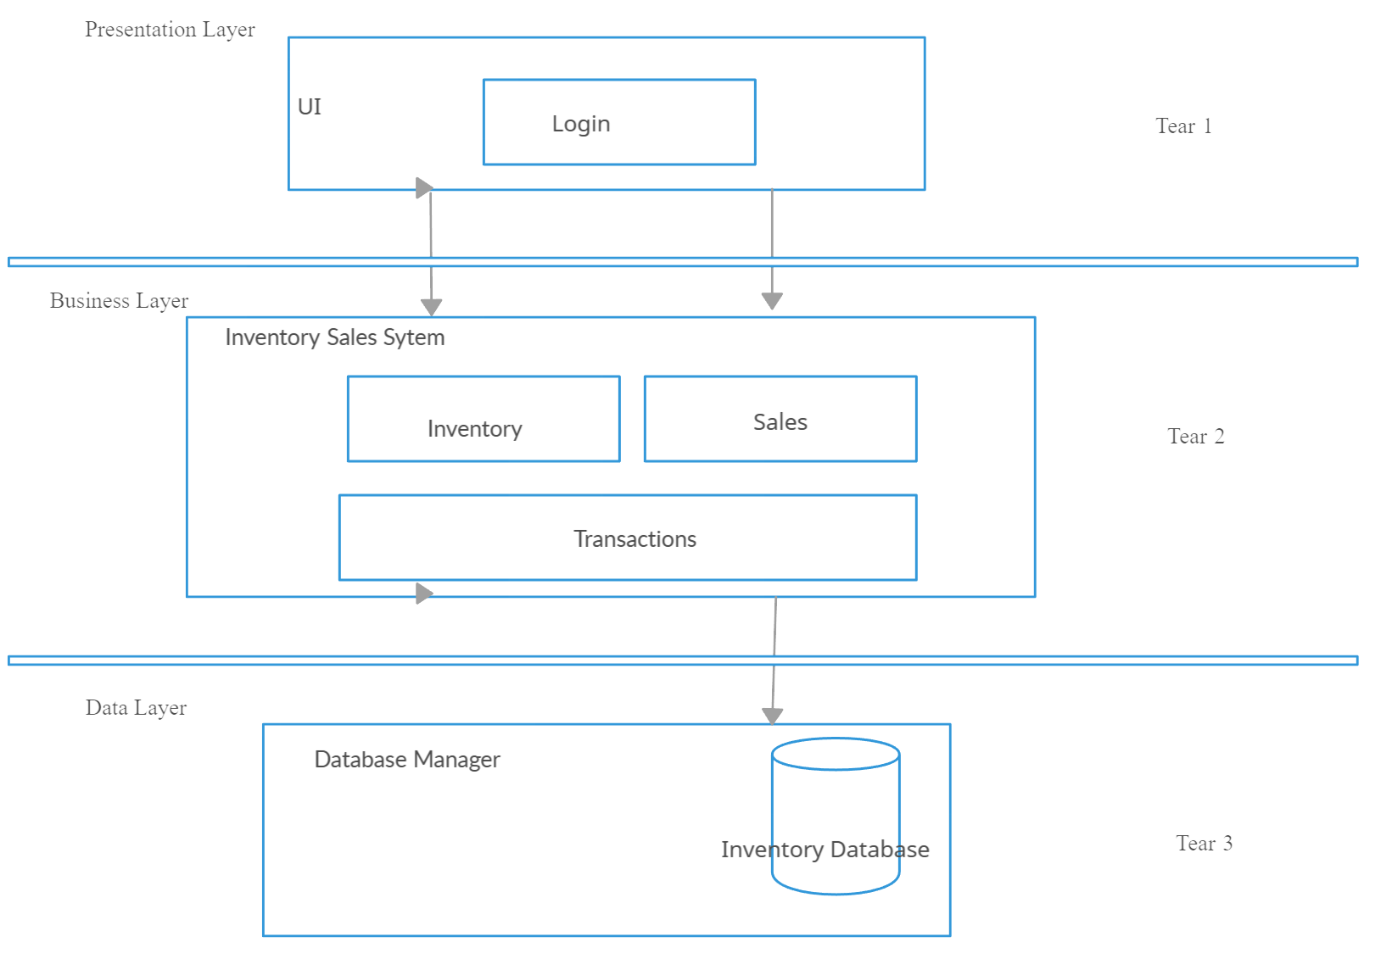
Design Document - ERD

Slide 10
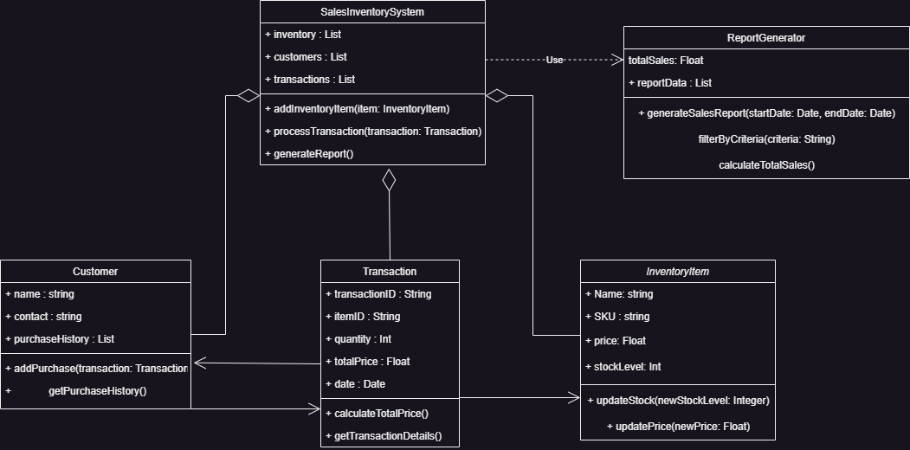
Design Document – ERD

Slide 11
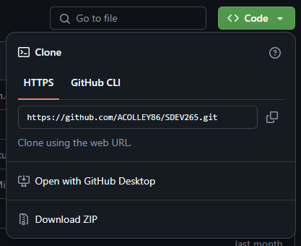
Design Document – Installation
Steps to Install
Download Code:
Visit Github, download Zip file or clone the repository.
Set up Environment:
Open the project folder in an IDE (e.g., VS Code).
Run the Program:
Execute the main file (sales.py) using python sales.py

Slide 12
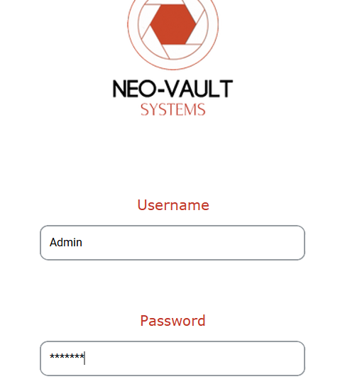
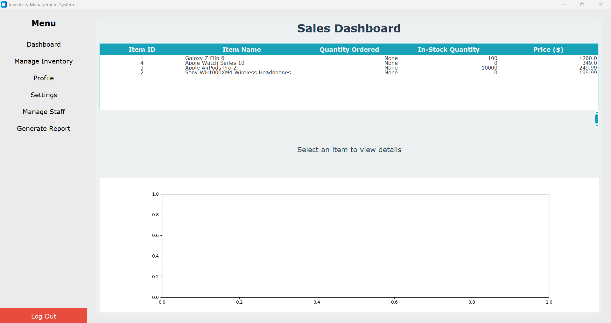
Design Document – Login and Main Menu
Login
Launch the application, log in using the default Username (Admin) and password (TESTING), and access the main menu.
Main Menu Options
Dashboard
Manage Inventory
Profile
Settings
Manage Staff
Generate Report

Slide 13
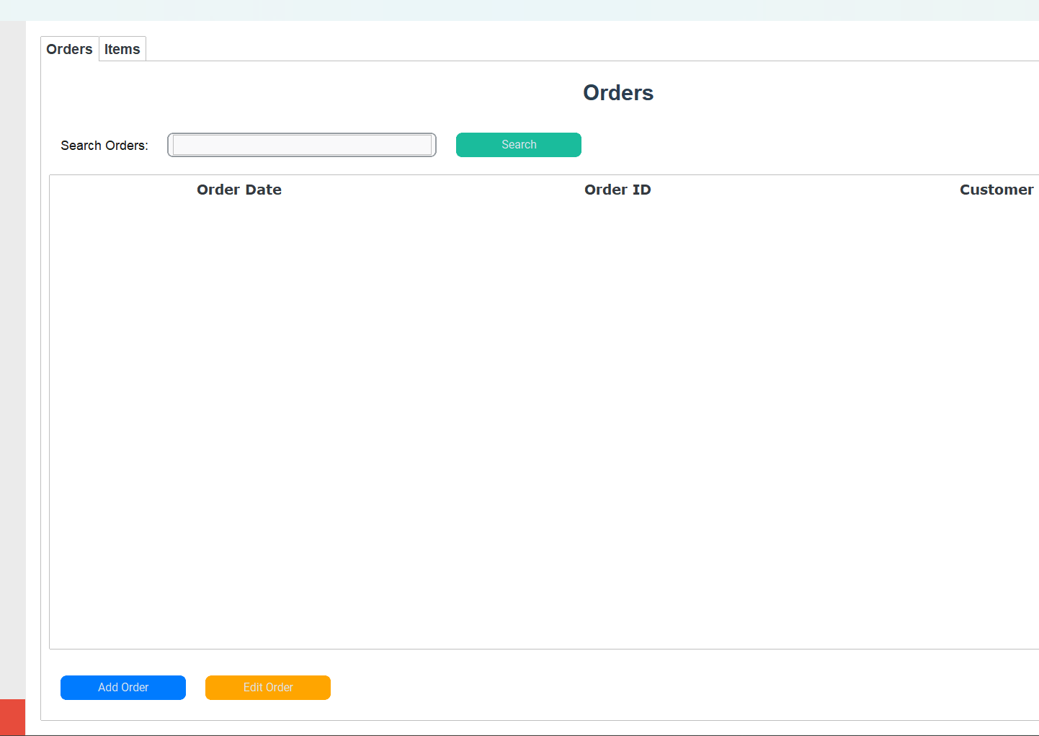
Manage Inventory
Add Order: Click the ‘Add Order’ button to initiate a new customer order.
A window will pop up and prompt you to enter the Customer Name, item ID, Product Name, Quantity, Price, Delivery Address, Contact Information, and Agent ID.

Slide 14
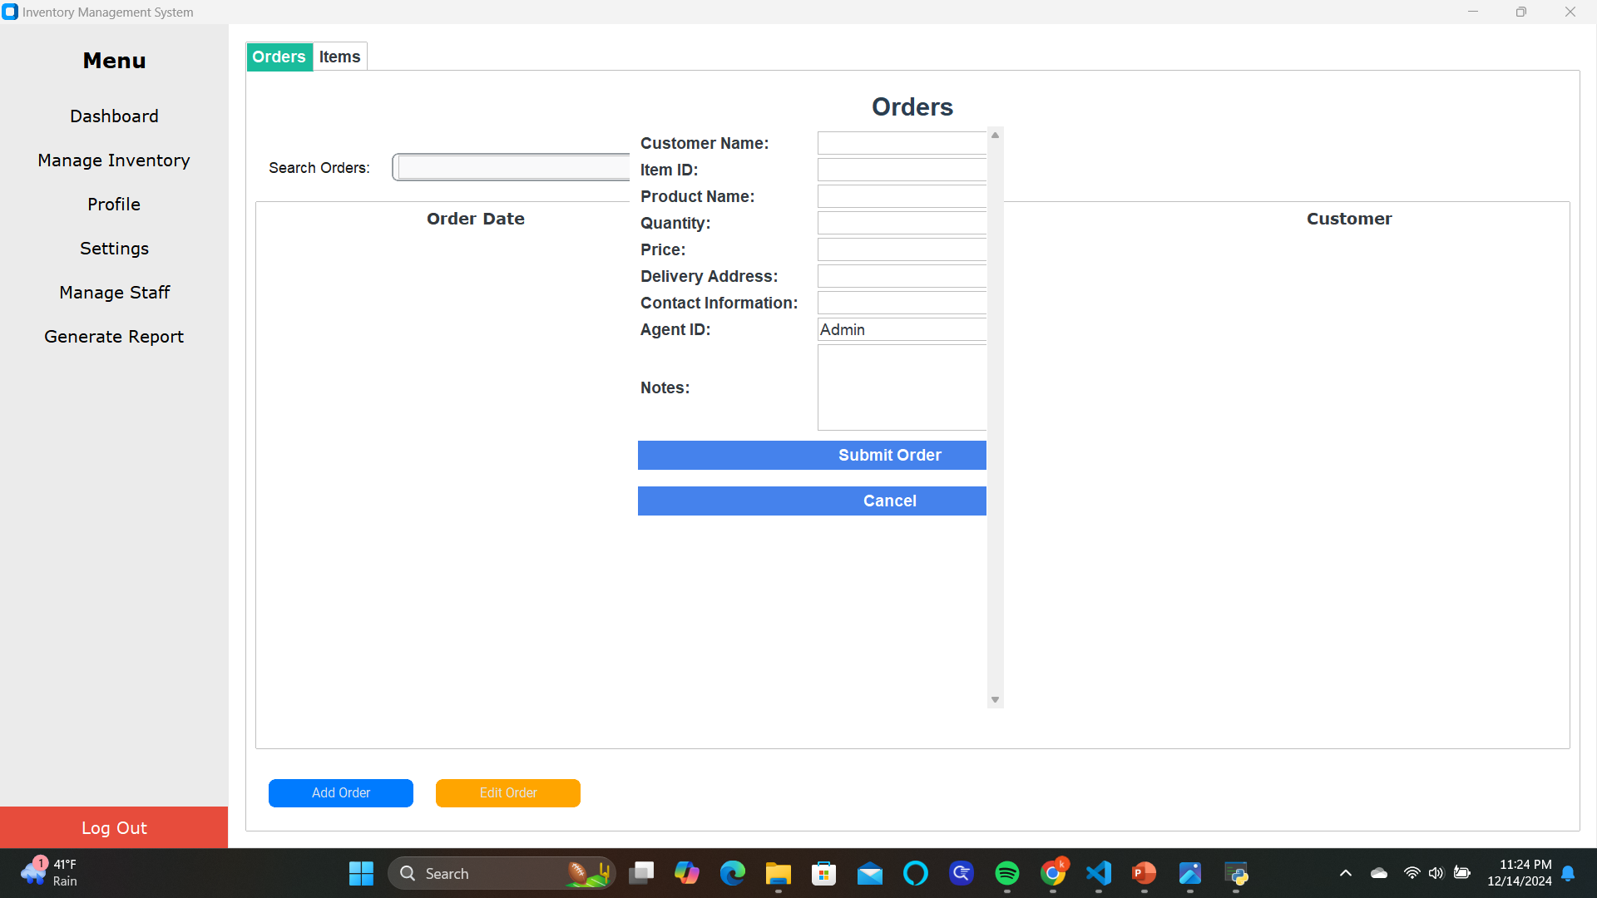

Slide 15
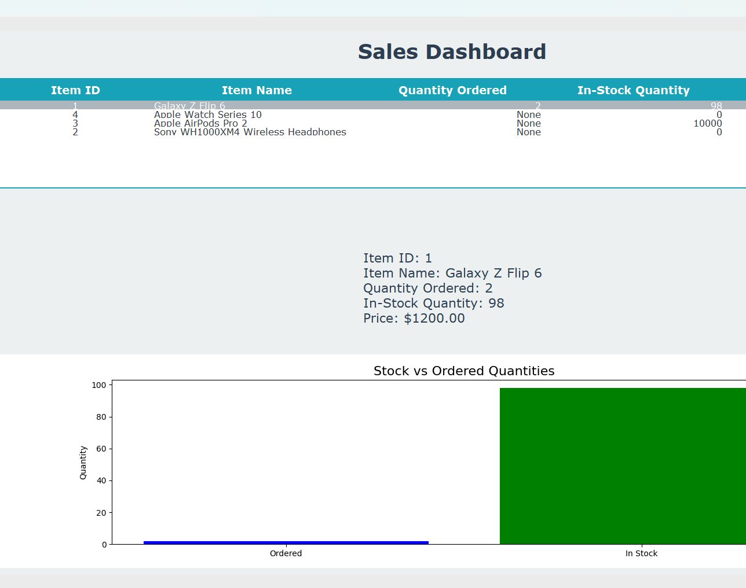
Sales Dashboard
Keep track of in-stock and ordered quantities of items.

Slide 16
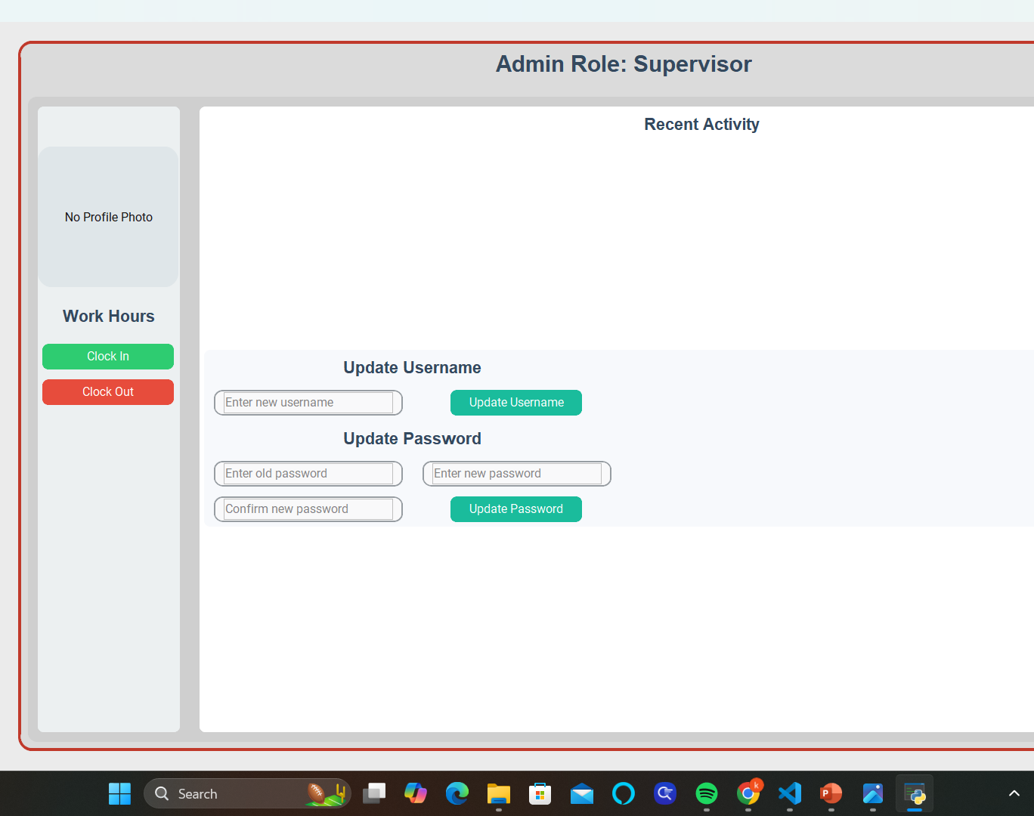
Profile
Click the ‘Clock In’ button to begin a shift and ‘Clock out to end a shift.
You can create a new username and password in the Profile Window as well.

Slide 17
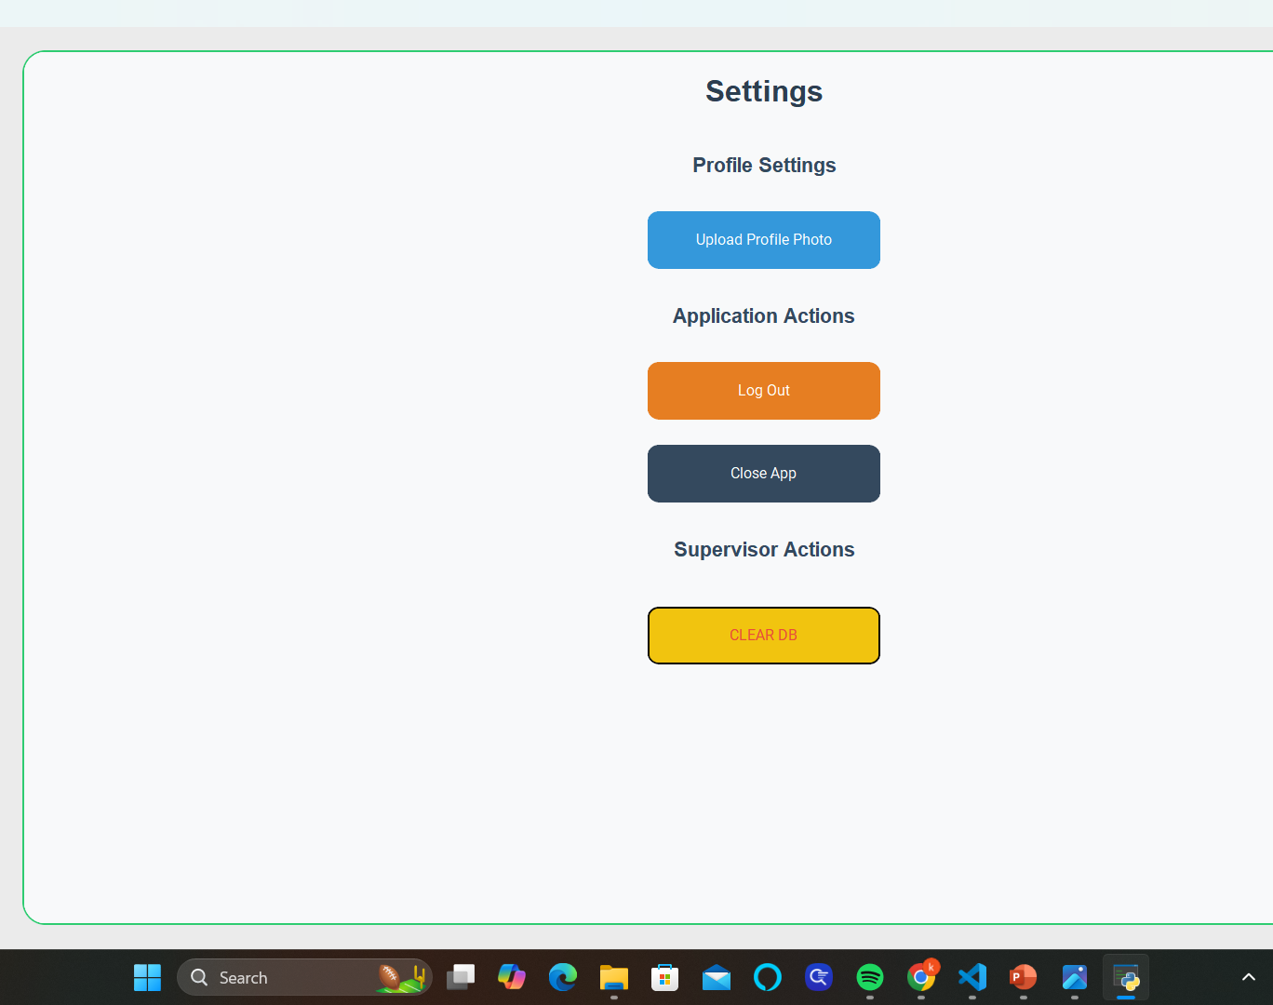
Settings
The Setting window allows you to do the following:
Upload a profile photo
Logout of the app
Close the app
Clear the database

Slide 18
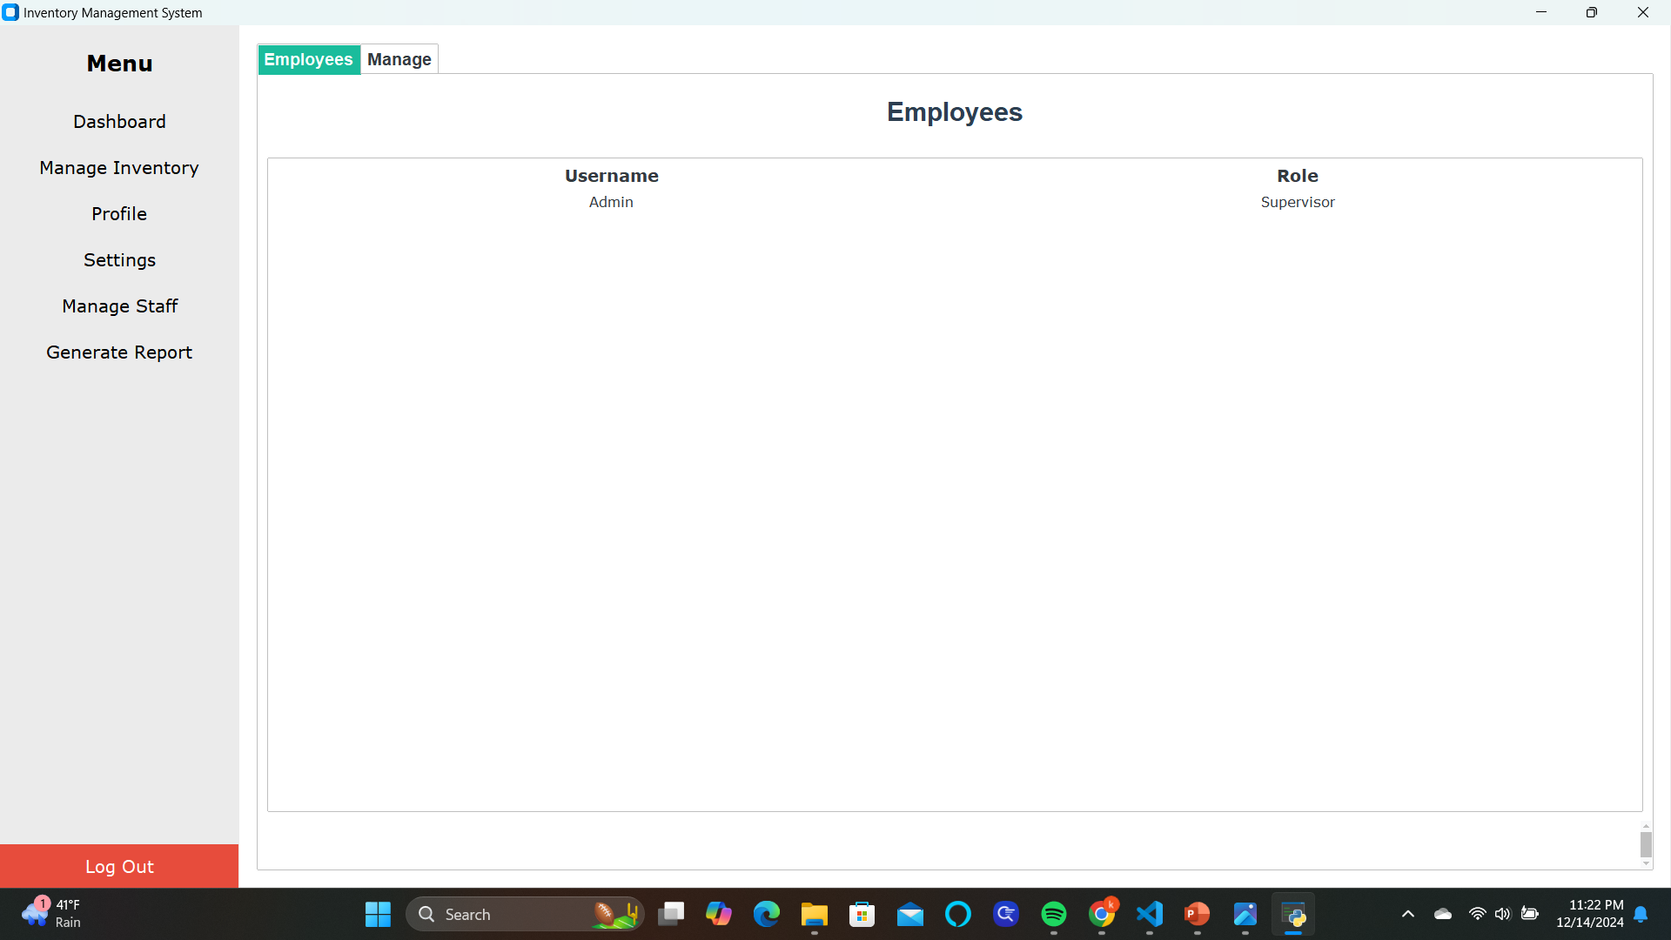
Manage Staff
Select an employee to manage then click the ‘Manage’ button.
You will have the option to terminate the user selected or change their role.

Slide 19
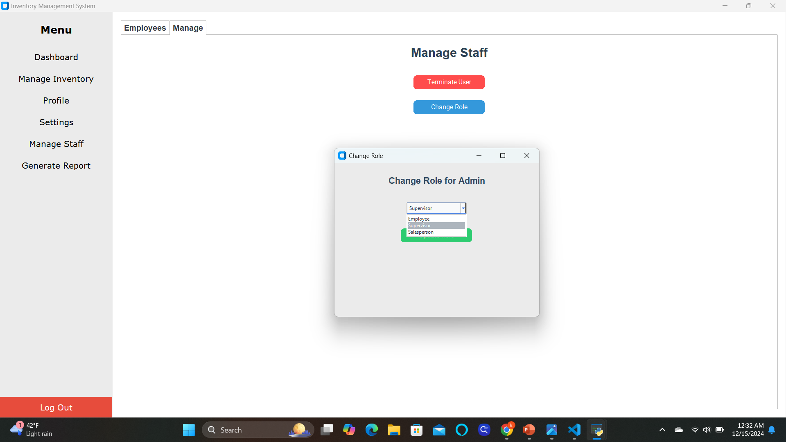

Slide 20
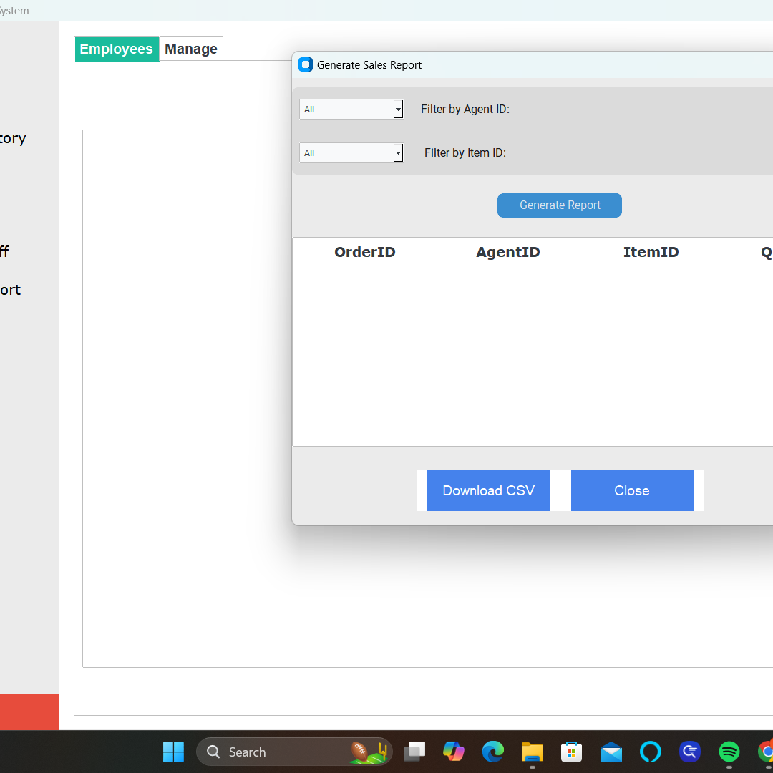
Generate Report
Reports of past orders can be generated using the ‘Generate Report’ button.
Use the dropdown menus to filter reports by Agent ID and Item ID
The report will include the following information: Order ID, Agent ID, Item ID, and Quantity.

Slide 21
Project Summary
Project Title: Sales Inventory System
Objective: To develop a user-friendly application for managing sales, inventory, and user roles efficiently in liquor stores.
Key Features:
Inventory Management: Add, modify, and delete products.
User Management: Create and remove user accounts with specific roles.
Technical Details:
Languages & Tools: Python, GitHub, IDE (e.g., VS Code).
Workflow: Backup via GitHub, task tracking with Trello.
Outcomes:
Streamlined store operations.
Improved accuracy in sales and inventory management.
Enhanced user experience through an intuitive GUI.

